Slide 1
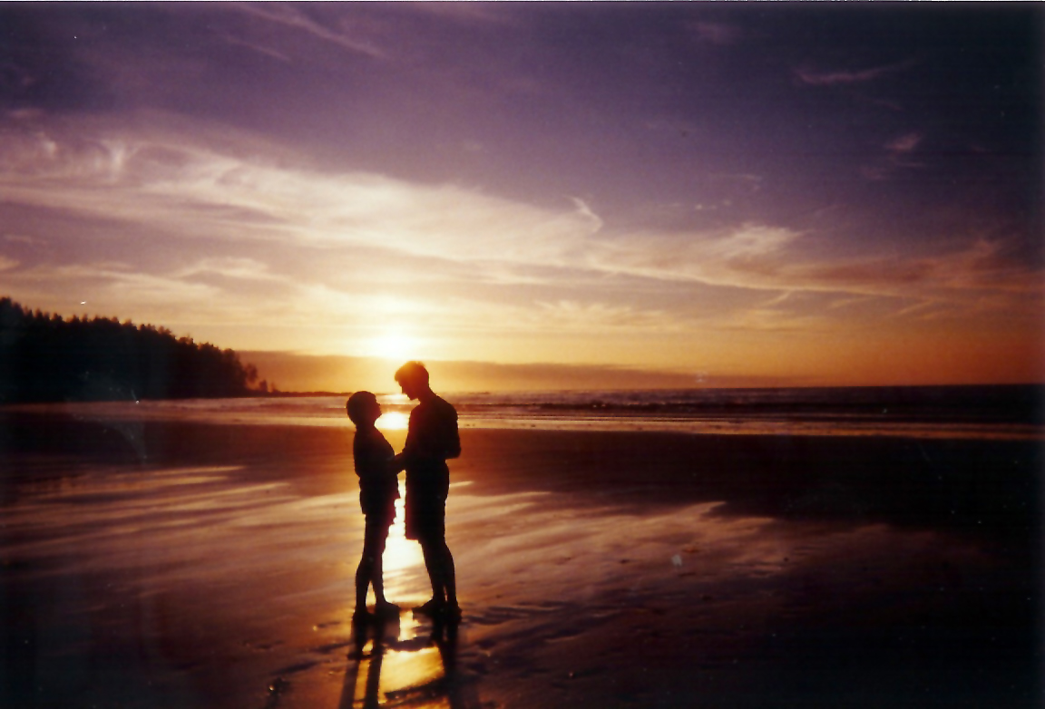
Unit 6 Romance

Slide 2
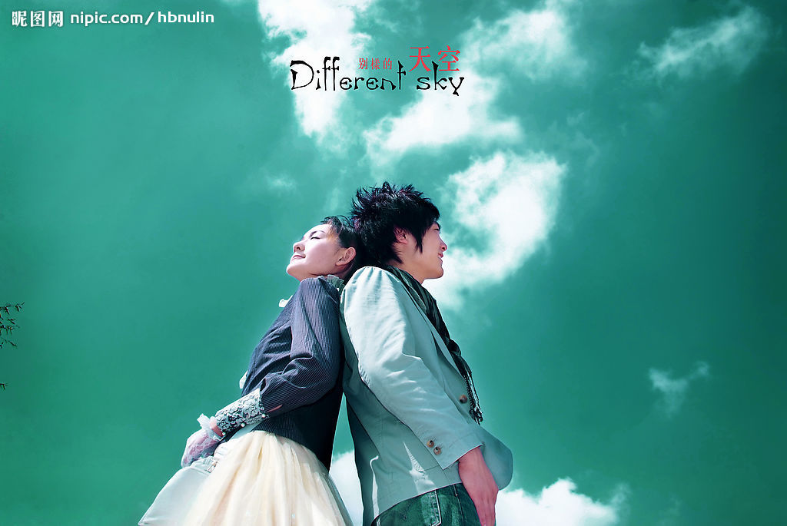
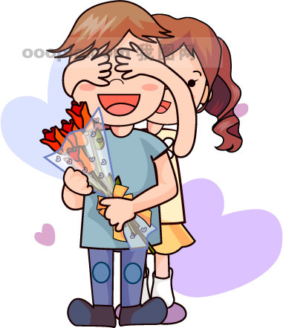
Warm-Up
Mini-News Reading
News Listening
Text A
Text B

Slide 3
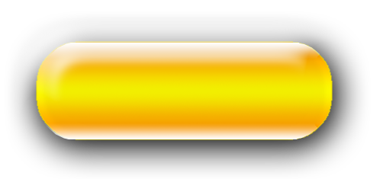
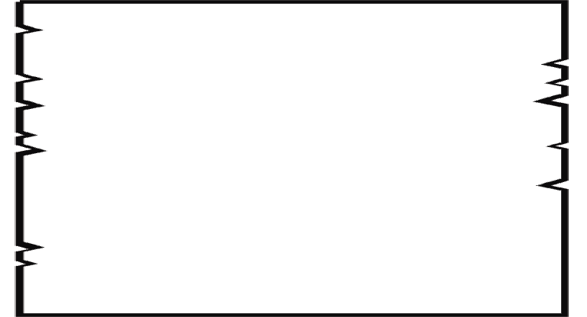


Warm-up
How did you spend your last Valentine’s Day?
In your opinion, what is a perfect way of finding your ideal partner?
What factors do you think are important
in selecting your partner?
?
?

Slide 4

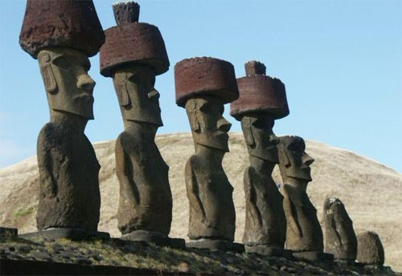
Mini-News Reading
    Key Words & Expressions:
    Easter Island: n. 复活岛
    stunning: adj. 令人吃惊的；极好的，出色的
    Question: Are you amazed at the news? What is your unique plan of your own wedding celebration in the future?

Slide 5
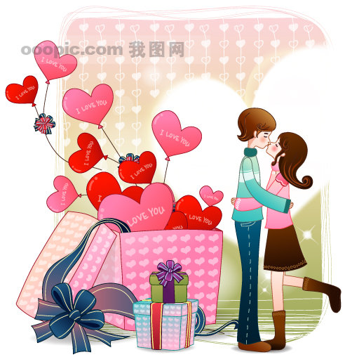


News Listening
The Modern Matchmakers
Text A

Slide 6

News Listening
    Keys:
    1. engagement and wedding rings
    2. bridesmaids
    3. the fourth finger of the left hand
    4. a direct connection
    5. ensure good luck
    6. wards off evil spirits
    7. Ancient Roman and Greek
    8. a mixture of flowers and herbs
Text A

Slide 7
Text A
News Listening
    Keys:
    9. similar to the bride
    10. confuse the spirits
    11. all legal contracts
    12. a lifelong contract
    13. carrying her through the doorway
    14. originated the Western tradition
    15. wore their best dress

Slide 8
The Modern Matchmakers
Text A

Slide 9
Text A
Text Analysis
Directions: Read Text A and try to divide it into three
parts. Then summarize the main idea of each part.
Part 1 (para. 1-3): The Internet has
emerged as a new type of matchmaker.
Part 2 (para. 4-11): Internet dating sites
serves as no blueprint for a perfect partner.
Part 3 (para. 12-13): It is still difficult to find
one’s true love in the supermarket of love.

Slide 10

Comprehension
Read paragraphs 1-3 and answer the following questions.
1. Why do traditional matchmakers get involved in romantic activities?
2. What is referred to as a newly-found matchmaker? How does the new matchmaker differ from the old ones?
Text A

Slide 11
Comprehension
1. Why do traditional matchmakers get involved in romantic activities?
Traditional matchmakers such as parents, priests, friends or bureaucrats usually wanted to get involved in romantic activities because they thought they knew what it took to pair people off better than those people knew themselves.
Text A

Slide 12
Text A
Comprehension
2. What is referred to as a newly-found matchmaker? How does the new matchmaker differ from the old ones?
The internet is referred to as a newly-found matchmaker. It differs from the old ones because internet dating sites promise two things that neither traditional matchmakers nor chance encounters offer. One is a vastly greater choice of potential partners. The other is a scientifically proven way of matching suitable people together, enhancing the chance of “happily ever after”.

Slide 13
Text A
Comprehension
Read paragraphs 4-11 and answer the following questions.
3. How do psychological experts respond to internet dating?
4. Which commercial practice has exerted a negative effect on testing the effects of algorithms?
5. What are the two major defects that overstate the power of internet dating?

Slide 14
Comprehension
3. How do psychological experts respond to internet dating?
Some psychologists are deeply unconvinced about the whole multi-billion-dollar online dating industry. They hold a doubtful view towards such questions as whether internet dating leads to better outcomes, or whether “scientifically tested algorithms” actually works.
Text A

Slide 15
Text A
Comprehension
4. Which commercial practice has exerted a negative effect on testing the effects of algorithms?
The common practice of preserving intellectual property as trade secrets rather than making it public by patenting it has exerted a negative effect on testing the effects of algorithms. There is thus no independent scientific evidence that any internet dating site's algorithm for matching people together actually does enhance the chance of their hitting it off when they meet.

Slide 16
Comprehension
5. What are the two major defects that overstate the power of internet dating?
First of all, as is assumed but not tested, those with compatible personalities make more successful couples than those without. Therefore, they match people with compatible personality traits. However, a recent survey has shown that members of couples with similar personalities were indeed happier than those whose partners were dissimilar, but the difference was as tiny as 0.5%.
Secondly, some dating-site algorithms do not take the high-handed “we know best” approach but, rather, let the punter decide what he or she is looking for. The crucial assumption here is that what people think they want is what they actually need. However, research data has demonstrated that people are not good at knowing what they want and they tend to change their minds some time later.

Slide 17
Comprehension
Read paragraphs 12-13 and answer the following questions.
* What is the effect of facing abundant allegedly suitable matches?
* Is there a shortcut before Cupid's arrow strike?
6. Do you definitely believe that online dating companies can find a soul mate for you as they usually claim?
Text A

Slide 18
Text A
Comprehension
* What is the effect of facing abundant allegedly suitable matches?
Studies showed that when faced with abundant choice, people pay less attention to characteristics that require thinking and conversation to evaluate (occupational status and level of education, for example) and more to matters physical. Choice, in other words, dulls the critical faculties.

Slide 19

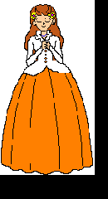
Comprehension
* Is there a shortcut before Cupid's arrow strike?
There is no shortcut because love is as hard to find on the internet as elsewhere. You may be just as likely to luck out in the local café, or by acting on the impulse to stop and talk to that stranger on the street whose glance you caught, as you are by clicking away with a mouse and hoping that, one day, Cupid's arrow will strike.

Slide 20
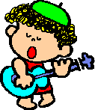
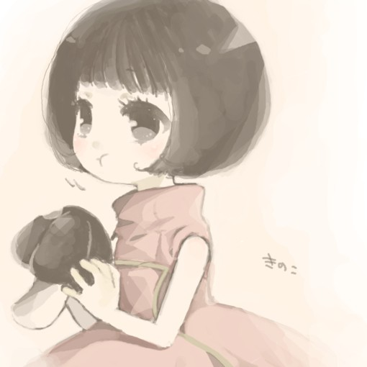
Text A
Comprehension
6. Do you definitely believe that online dating companies can find a soul mate for you as they usually claim?
(Open Question)

Slide 21
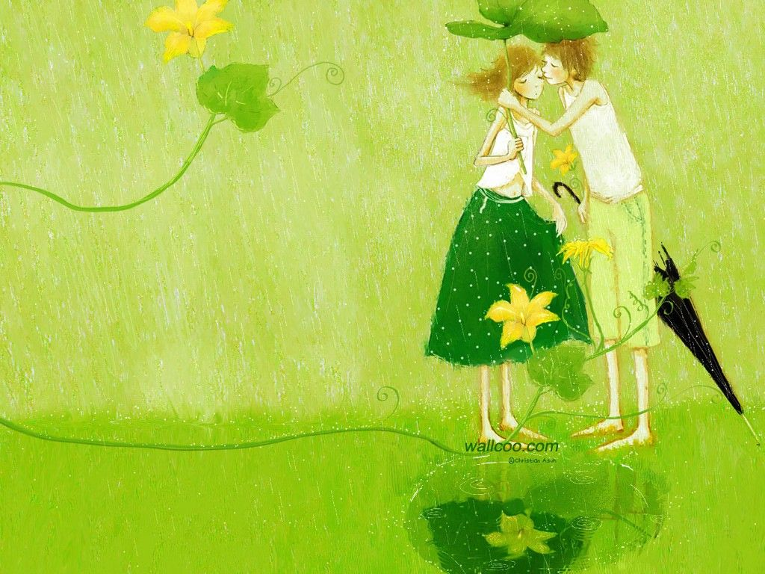
Text A
Summary
Keys:
1. online
2. profit
3. popularity
4. convincing
5. potential
6. proven
7. attitude
8. blueprint
9. intellectual property
10. disclose
11. computerized
12. compatible
13. amounts to
14. distraction
15. Cupid's arrow

Slide 22
Text A
Chart-Filling
Keys:
traditional matchmakers
chance encounters
Internet dating
partner-matching algorithms
oodles of choice
independent scientific evidence
similar and dissimilar personalities
the very volume of alternatives

Slide 23


Text B
Why Consumers Just Don’t
Feel the Love for Valentine’s Day

Slide 24
Text B
Comprehension
Read Text B and answer the following questions.
1. What is the sharp contrast between Valentine’s Day in the past and that of the present?
2. What is people’s common response to Valentine’s Day nowadays?
3. Under the background of the gender equality, who will resume more responsibility in terms of Valentine’s Day, male or female? Why is that?
4. Why is the totality of the Valentine’s expenditure going up steadily while the spending on sweethearts actually decreases?
5. What is your understanding of Valentine’s Day? How do you plan to celebrate the next Valentine’s Day?

Slide 25
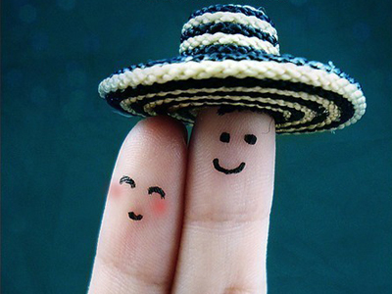
1. What is the sharp contrast between Valentine’s Day in the past and that of the present?
Text B
Valentine’s Day is a pale, pink shadow of its former self. Once associated with throbbing red passion and romance, today it’s more likely to elicit a sense of obligation, dread or apathy.

Slide 26
2. What is people’s common response to Valentine’s Day nowadays?
Text B
Most of the dozens of consumers who have been interviewed were tepid, at best, when asked about their feelings for the holiday. Very few thought of Valentine’s Day as a particularly romantic event, and hardly anyone refers to the day as his or her favorite day of the year.

Slide 27
3. Under the background of the gender equality, who will resume more responsibility in terms of Valentine’s Day, male or female? Why is that?
Text B
Many people in relationships aren’t inspired to participate in the holiday because of romance, but simply because they feel they must. They’ll spend heavily to ensure there are no hurt feelings. Especially men. While gender neutrality is on the rise, Valentine’s Day is apparently still mostly a man’s job.

Slide 28
4. Why is the totality of the Valentine’s expenditure going up steadily while the spending on sweethearts actually decreases?
Text B
Because Valentine’s Day has been expanded beyond the realm of romance. For instance, the holiday has gone to pets, friends, co-workers, parents, teachers and kids. This trend has been in place for several years now. Much of this is due to ramped-up efforts on the part of marketers and retailers. It’s also because consumers simply don’t want to have anyone they love, like and just are happy to work with feeling left out.

Slide 29
5. What is your understanding of Valentine’s Day? How do you plan to celebrate the next Valentine’s Day?
Text B
Open Question.

Slide 30
Translation
Once associated with throbbing red passion and romance, today it’s more likely to elicit a sense of obligation, dread or apathy. (para.1)
情人节曾经一度令人联想到砰然心跳的激情和浪漫，而今天却更容易使人产生一种义务、畏惧和漠然的感觉。

Slide 31
Translation
However contrived and forced, the holiday can serve as a nasty reminder of what some singles want but don’t have, or just a day when they simply feel like they’re missing out. (para.11)
无论如何精心设计、强势亮相，情人节对于那些单身男女而言，预示着一种可望而不可及的苦涩，或者意味着被遗忘与冷落的一天。

Slide 32
Buzzwords

Slide 33
Thank You !

